Slide 1
Engaged Care Staff Portal
One place for tasks, compliance, cars, forms and a website that answers questions
Briefer · November 2026
Notes:
A short tour of what the portal does, what's included, and what it costs.

Slide 2
Today, the work is spread across too many places
Planner boards
SharePoint lists
Tasks, but no registers, no escalation
Permissions set by hand and easy to overshare
Emails and spreadsheets
Licences per person
Evidence hard to find at audit time
Every casual needs a paid account

Slide 3
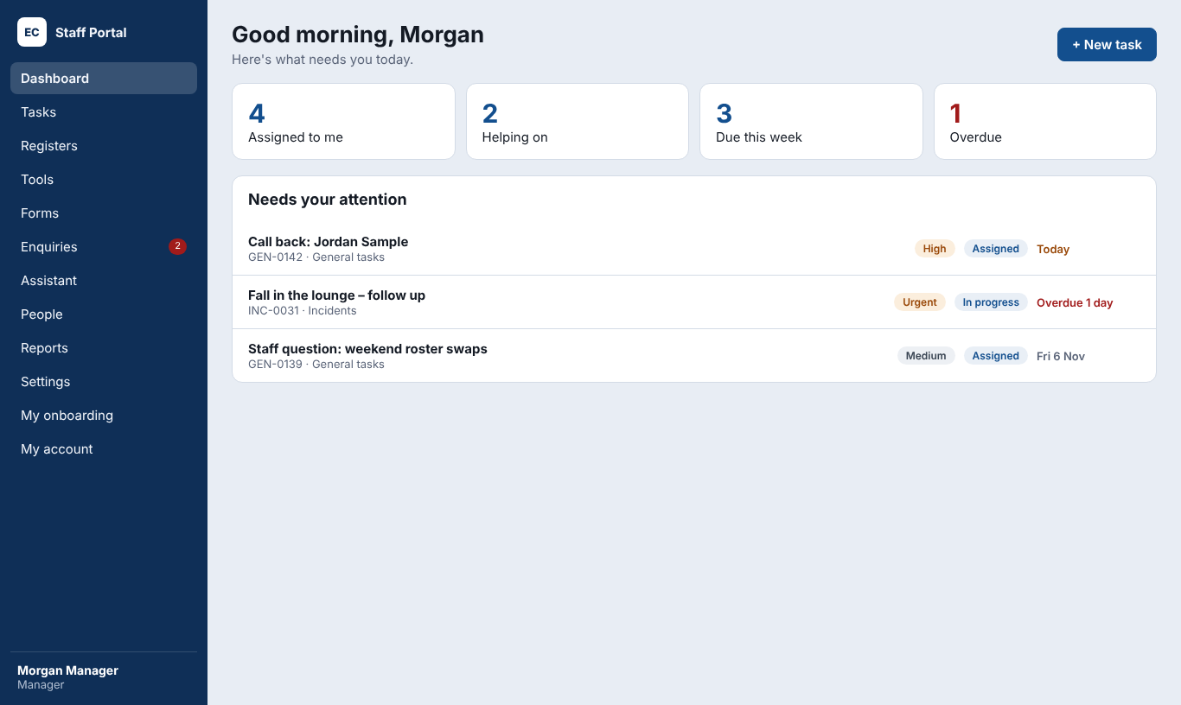
The Staff Portal brings it into one system
Tasks and registers with due dates, helpers, approvals and escalation
Role-based access, enforced by the database
Dashboard, reports, scoreboard and change log
Works on computers and phones, data stored in Sydney

Slide 4
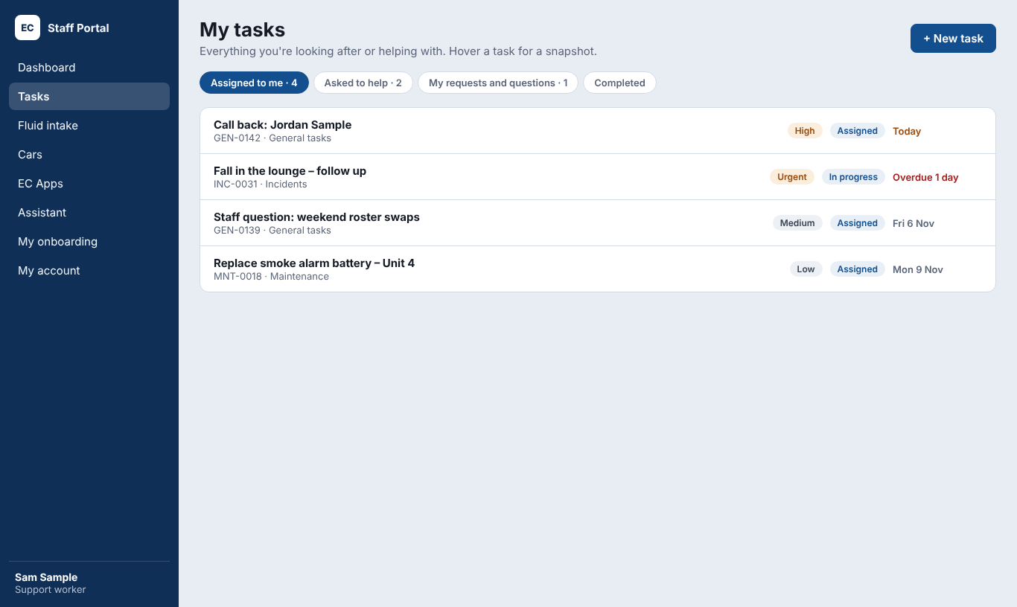
For staff: simple, on any device
My tasks with a snapshot on hover
Questions as Staff question tasks, followed up in one place
My onboarding: read, confirm, upload, answer forms
PIN-locked phone apps for cars and daily records

Slide 5
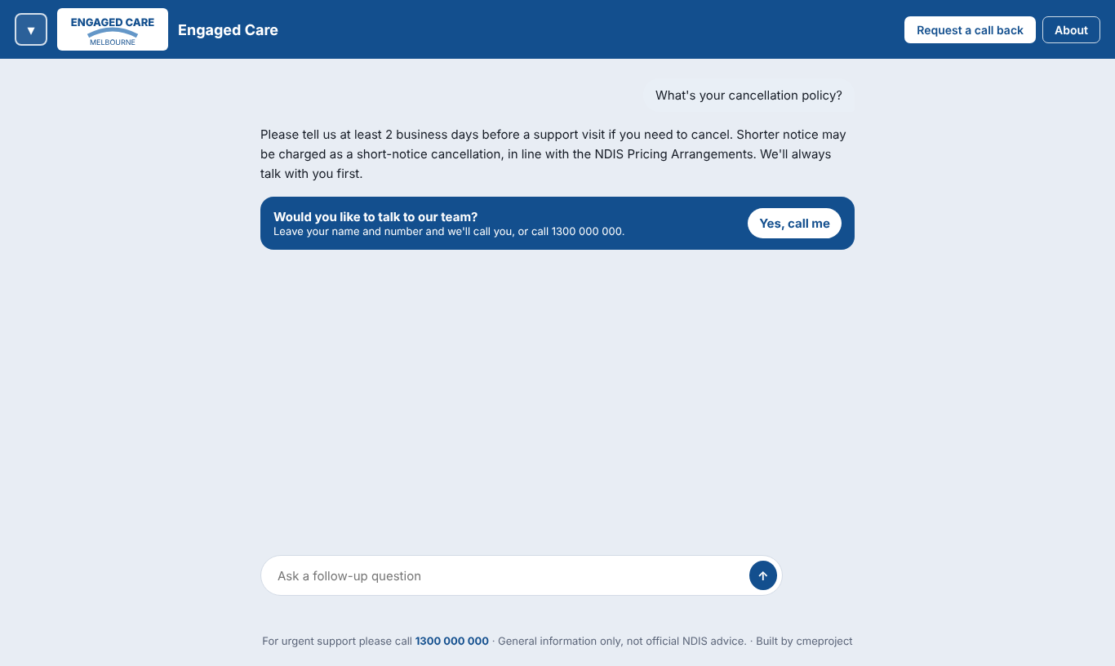
A website that answers questions from your documents
Visitors ask about services and policies; staff get staff-only answers too
Answers only from your documents, or listed websites like ndis.gov.au
Request a call back becomes a task for intake, due next business day
About page and SEO settings for Google

Slide 6
Core plus premium add-ons, switched on when needed
Module | Type | Monthly
Tasks, registers, people, dashboard, two-factor | Core | A$390 (30 staff)
Compliance and onboarding | Add-on | A$120
Forms | Add-on | A$80
Cars and Cars app | Add-on | A$90
Staff app | Add-on | A$60
Feature builder (each feature) | Add-on | A$40
Website and Assistant | Add-on | A$190
Reports and exports | Add-on | A$50
Complete bundle (Core plus everything) | Bundle | A$790

Slide 7
Safe by design
Sydney
Every table
2FA + lockout
Audited
Data stays in Australia
Protected by the database itself
Two-factor login; 5 wrong passwords lock for 15 minutes
November 2026: one small gap found and fixed

Slide 8
What it costs
A$4,500
A$390
A$790
~A$90
One-off setup
Core, per month (30 staff)
Everything, per month
Running costs, per month
Running costs: Vercel Pro about A$31, Supabase Pro about A$39, email free to start, domain about A$25 a year, AI by use (about A$1 to A$2 per 1,000 answers on Haiku)
Save 10% by paying a year ahead

Slide 9
Live in two weeks
Days 1 to 2
Days 3 to 5
Days 6 to 7
Days 8 to 9
Day 10
Accounts, domain, branding
Roles, registers, compliance, import
Website, documents, test the Assistant
Training and phone apps
Go live

Slide 10
Next steps
Choose Core and the add-ons
Move Vercel and Supabase to paid plans
Book setup and training
Go live, then review at 90 days

